Slide 1

8th Grade Math: Pre-Algebra
Unit 14, Lesson 3 Calculating Theoretical Probability Volume 2, pg. 320

Slide 2


Benchmarks
MA.8.DP.2.1
Determine the sample space for a repeated experiment.
MA.8.DP.2.2
Find the theoretical probability of an event related to a repeated experiment.
volume 2, pg. 320

Slide 3
Integrated Mathematical Thinking and Reasoning Standards
MA.K12.MTR.2.1 Demonstrate understanding by representing problems in multiple ways.
MA.K12.MTR.7.1 Apply mathematics to real-world contexts.
volume 2, pg. 320

Slide 4

Learning Target
I can calculate the theoretical probability of the outcomes in a repeated experiment.
volume 2, pg. 320

Slide 5

Warm-Up
volume 2, pg. 320

Slide 6

14.3.1 Warm-Up: Solving Proportions
Solve the proportions for the given variable.
$\frac{n}{54}=\frac{20}{100}$ $n=$
$\frac{x}{6}=0.5$ $x=$
$20\%=\frac{6}{a}$ $a=$
volume 2, pg. 320

Slide 7

Guided Instruction
volume 2, pg. 321

Slide 8

14.3.2 Guided Instruction: Determining Probability
Probability can be used to better understand random processes. One way to analyze a random process is by calculating the theoretical probability of the events in a sample space.
Theoretical probability is a number between 0 and 1 that represents the likelihood of an event in a theoretical model based on a sample space. If all outcomes in the sample space are equally likely, then the theoretical probability of an event is the ratio of the number of outcomes in the event to the number of outcomes in the sample space.
volume 2, pg. 321

Slide 9
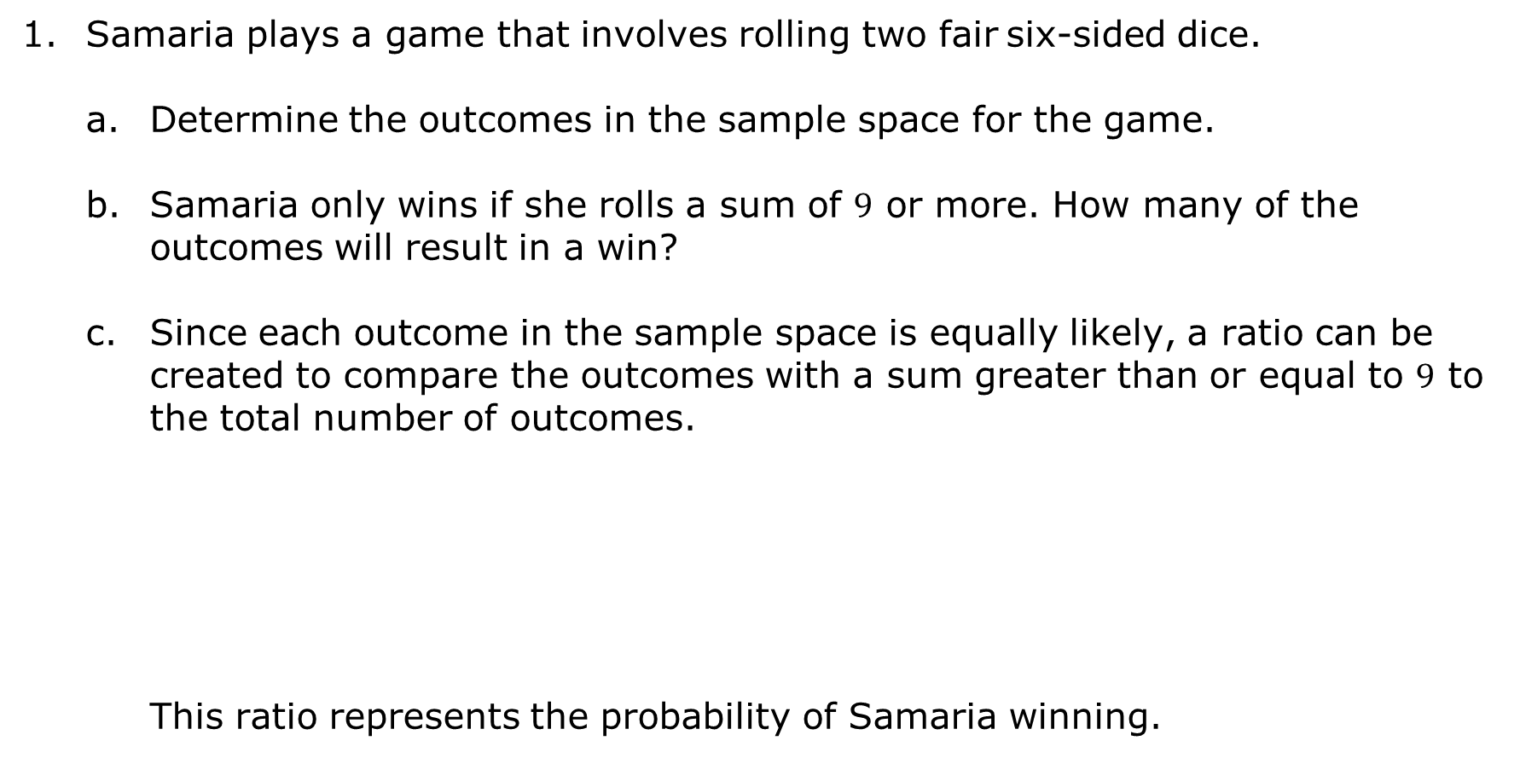
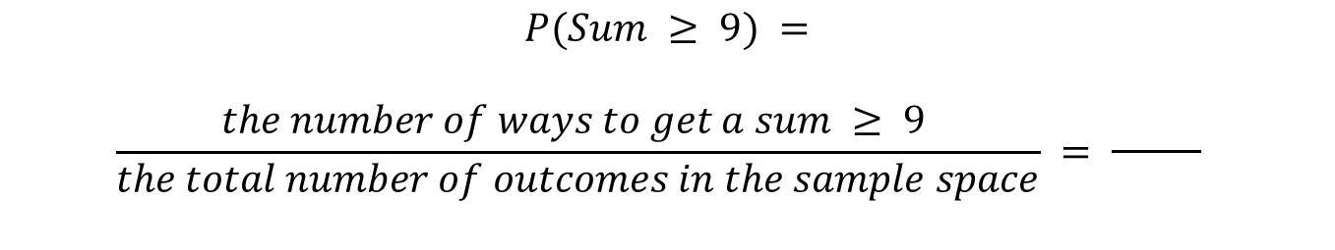
Samaria plays a game that involves rolling two fair six-sided dice.
Determine the outcomes in the sample space for the game.
Samaria only wins if she rolls a sum of $9$ or more. How many of the outcomes will result in a win?
Since each outcome in the sample space is equally likely, a ratio can be created to compare the outcomes with a sum greater than or equal to $9$ to the total number of outcomes.
This ratio represents the probability of Samaria winning.
$$P(Sum ≥ 9) =$$
$$\frac{the number of ways to get a sum ≥ 9 }{the total number of outcomes in the sample space} = \frac{ }{ }$$
volume 2, pg. 321

Slide 10
Write the probability of winning as a fraction, decimal rounded to the nearest hundredth, and percentage rounded to the nearest tenth.
Fraction:
Decimal:
Percentage:
To calculate a theoretical probability, think through the random process and use the sample space to determine the probability of certain events in the sample space.
volume 2, pg. 321

Slide 11

Guided Practice
volume 2, pg. 322

Slide 12


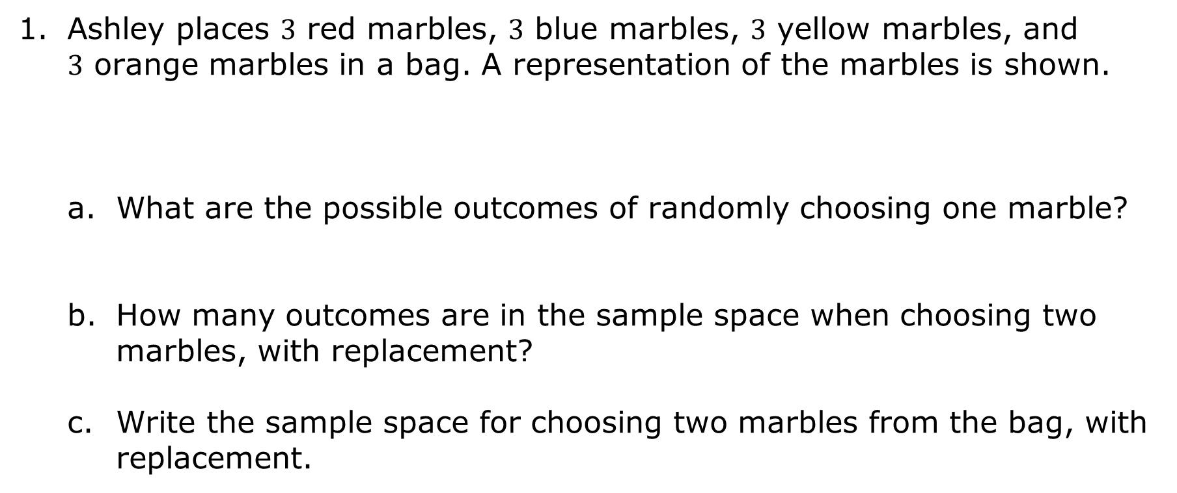
14.3.3 Guided Practice: Calculating Theoretical Probability
Ashley places $3$ red marbles, $3$ blue marbles, $3$ yellow marbles, and $3$ orange marbles in a bag. A representation of the marbles is shown.
What are the possible outcomes of randomly choosing one marble?
How many outcomes are in the sample space when choosing two marbles, with replacement?
Write the sample space for choosing two marbles from the bag, with replacement.
volume 2, pg. 322

Slide 13
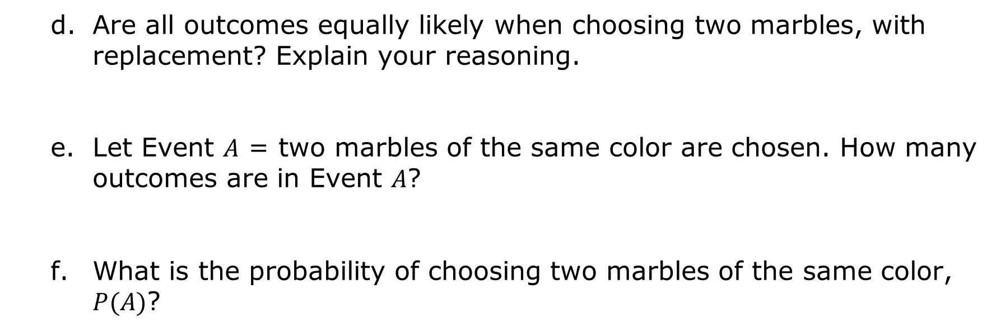
Are all outcomes equally likely when choosing two marbles, with replacement? Explain your reasoning.
Let Event $A$ = two marbles of the same color are chosen. How many outcomes are in Event $A$?
What is the probability of choosing two marbles of the same color, $P(A)$?
Fraction | Decimal | Percentage
volume 2, pg. 322

Slide 14
A fair coin with one pink side and one blue side and a fair spinner are shown.
If the coin is tossed and the spinner is spun, how many outcomes are in the sample space?
Write the sample space.
volume 2, pg. 323

Slide 15
What is the probability that both land on blue?
If the coin is tossed eight times, how many outcomes are in the sample space?
What is the probability that it lands on pink all eight times?
volume 2, pg. 323

Slide 16

Your Turn
volume 2, pg. 324

Slide 17
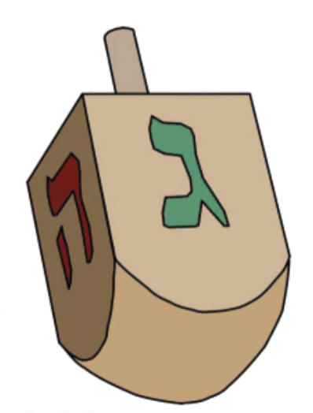
14.3.4 Your Turn!
A dreidel is a four-sided spinning top, played during the Jewish holiday of Hanukkah. Each side has a letter of the Hebrew alphabet: נ‎ (nun), ג‎ (gimel), ה‎ (hei), and ש‎ (shin).
David presents a new game to his friends involving a dreidel and a fair coin. If the dreidel lands on ה‎ (hei) and the coin lands on heads OR the dreidel lands on ג‎ (gimel) and the coin lands on tails, the player wins.
Define the sample space.
volume 2, pg. 324

Slide 18
How many outcomes result in a win?
What is the probability a player wins?
volume 2, pg. 324

Slide 19

Wrap-Up
volume 2, pg. 324

Slide 20
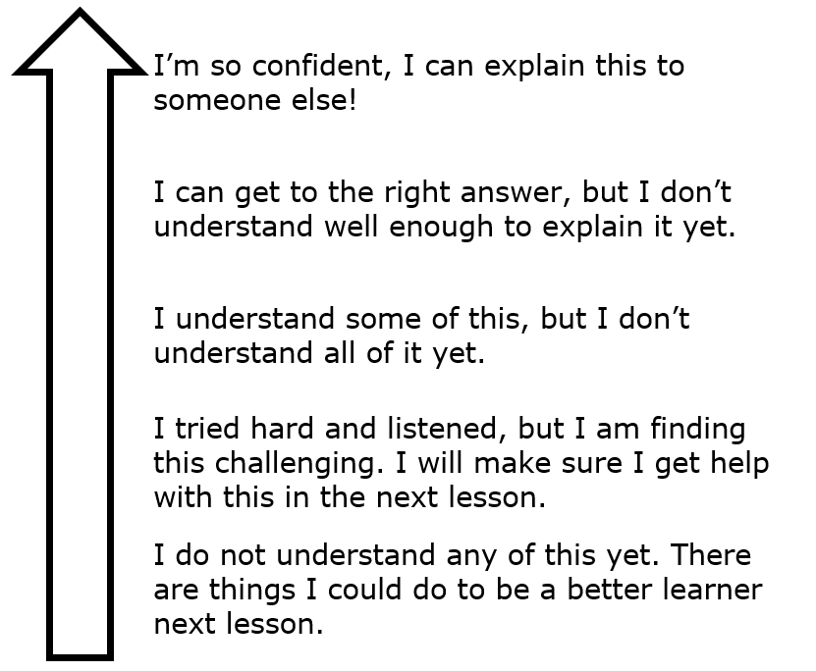
14.3.5 Wrap-Up: Reflection
Color in the arrow up to the statement that best describes your current understanding of calculating theoretical probability for a two-step experiment.
volume 2, pg. 324

